Slide 1
DeepRL for NLP
ANLP 2020
Nathan Tsoi

Slide 2
Overview
Discussion Questions
Motivation
RL and DeepRL
Applications in NLP
Das et al., Go for a Walk and Arrive at the Answer: Reasoning Over Paths in Knowledge Bases using Reinforcement Learning
Wang et al., Look Before You Leap: Bridging Model-Free and Model-Based Reinforcement Learning for Planned-Ahead Vision-and-Language Navigation
Jiang et al., Language as an Abstraction for Hierarchical Deep Reinforcement Learning
Discussion
Notes:
Here is a quick outline of the talk today.
One quick caveat before I start, I am by no means an expert in RL, and it’s a huge field. Many lectures and courses have spent countless hours covering even just the basics of RL. Not only is the field huge, but it’s currently very fast moving as well. I will try to give the highlights in 15 minutes, but will almost certainly leave something out, so when I send out the deck, I’ll include more links with resources on these topics.

Slide 3
Discussion Questions
Given the different approaches to learning: Supervised vs. Unsupervised vs. RL vs. DeepRL vs. Evolutionary Strategies, how does one make a decision about the best strategy for a given problem?
How might (Deep)RL based methods be blended with other methods for improved performance on tasks such as knowledge base querying or vision-and-language navigation? E.g. neuro symbolic methods? semantic priors?
In what other fields/areas/tasks could the compositional structure of language be leveraged as a representation?
Notes:
I want to take a moment to point out the discussion questions, so you can begin to think about them as we go through the material.
Also, please feel free to interject with questions or comments at any point throughout the presentation.

Slide 4

Notes:
So, to kick things off, I have a few fun videos that show applications of RL, mostly in other areas, such as this one in which a robotic arm farm is learning to manipulate objects using reinforcement learning.

Slide 5

Notes:
This example is from the OpenAI gym.
OpenAI gym is a simulation environment for training and testing reinforcement learning algorithms.
This is the classic cart-pole example, which might be considered the “hello world” of reinforcement learning.
The goal here is to control the black cart, which can only move along the x-axis, in such a way that the brown pole stays upright.

Slide 6
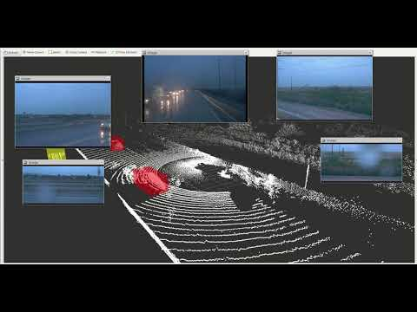
Notes:
And this video is showing sensor data from a self driving car. We have 3D lidar returns in white, car detections in red and a bunch of RGB camera views.
Now, we can think about some approaches to how one might solve this problem of getting a car to drive autonomously.
One could engineer a solution by measuring where the sensors are on the car and using geometry to create a virtual reconstruction of the scene given all the sensor inputs and then with those sensor inputs, engineer a large set of functions that apply a long list of rules about steering and breaking along with higher level rules such as specified by the department of motor vehicles, eventually encompassing all of the laws that govern driving.
This would be an approach that would probably work for the situations for which it was designed. The problem is that it is difficult to engineer a solution like this when there are so many different real world scenarios with different conditions that require different solutions. This is a solution that does not scale well.
Ok, so let’s narrow the problem slightly and concern ourselves with only steering control for the moment. We could engineer a solution like we were talking about before, but how do we go from raw pixel (that is camera) and voxel (or 3D lidar) data to steering commands?

Slide 7
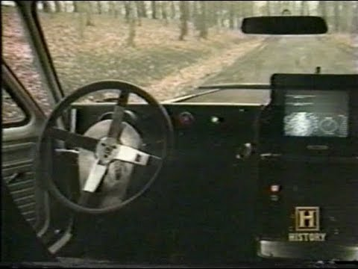
Notes:
It turns out that way back in 1989, Dean Pomerleau at CMU, had an answer to this exact question. The answer was ALVINN: “An Autonomous Land Vehicle in a Neural Network”

Slide 8
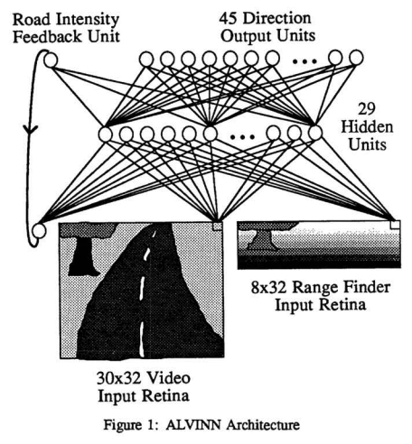
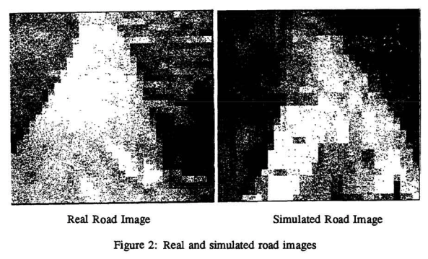
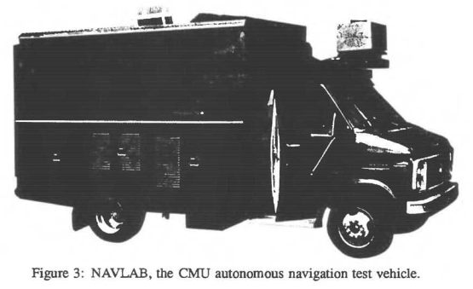
Pomerleau, Dean A. "Alvinn: An autonomous land vehicle in a neural network." Advances in neural information processing systems. 1989.
Notes:
What Dean did was collect and label 1200 images in simulation. Using these labeled images and backprop, they trained a neural network to steer their van, achieving 90% accuracy in simulation. They also tried in the woods under similar lighting conditions at ½ meter per second, which is just over 1 mile per hour, making it a total of 400 meters.
This was a fantastic work, but 90% accuracy, that’s just not going to cut it. Imagine if you turned the wrong direction 1 out of every 10 times. That would equate to multiple crashes every time you went somewhere in your car.
Fortunately, much progress has been made since Dean’s work.

Slide 9

https://waymo.com/open/about/
Notes:
Waymo just made their fully autonomous self driving service available to the general public in Arizona.
To make this possible they have an insane amount of labeled data they have trained their algorithms on. A small, I’m not sure how small, but a fraction of their dataset is available under their open data program. In this subset of their data are almost 2000, 20 second segments of real, labeled data at 10 hz, so that’s almost a ½ million datapoints with 5 lidars and 5 cameras at each point. Then each datapoint has labels for 4 classes: vehicles, pedestrians, cyclist and signs. Then each label has bounding box information in all the lidar and image data.
Now, this talk is not about self driving cars. What I want you to take away from this is the order of magnitude difference in labeled data between 1989 supervised self driving methods and today’s supervised self driving methods.
What this really points to is the amount of effort required to make a supervised learning system work in the real world

Slide 10
Reinforcement Learning
Supervised learning
Goal: learn to generalize
Unsupervised learning
Goal: find hidden structure
RL
Goal: maximize reward signal
Whole problem vs. subproblem
Reinforcement learning: An introduction. Sutton & Barto
Notes:
This raises the question, what are supervised learning and unsupervised learning and how does this fit into RL?
Supervised learning learns from labeled data. The goal is to generalize. An example of this is recognizing cats in unseen images by learning what a cat looks like from a bunch of cat photos.
Unsupervised learning learns from unlabeled data. The goal is to find hidden structure, visualization techniques such as the t-Stochastic Neighbor Embedding or t-SNE is a popular example.
RL is all about learning from experience.
Distinction between Supervised learning, unsupervised and RL
RL: the agent has to operate despite significant uncertainty about the environment
When RL involves planning, need to navigate the interplay between
planning and real-time action selection
Deal with acquiring models of the environment and improving them

Slide 11
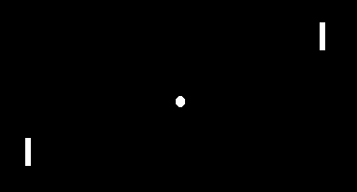
Reinforcement Learning
http://karpathy.github.io/2016/05/31/rl/
Notes:
Let’s first look at a concrete example: The game of Pong.

Slide 12
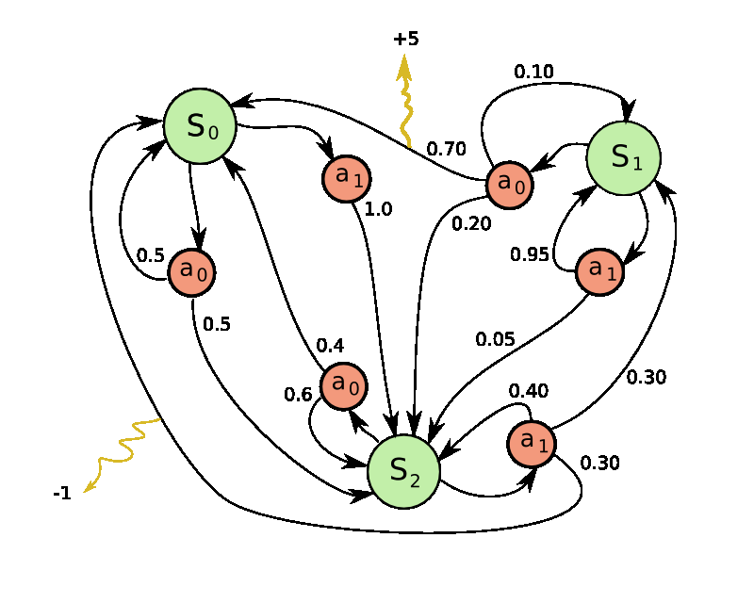
Reinforcement Learning
http://karpathy.github.io/2016/05/31/rl/
Notes:
Pong is a special case of a Markov Decision Process (MDP):
A graph where each node is a particular game state and each edge is a possible transition.
Each edge also gives a reward, and the goal is to compute the optimal way of acting in any state to maximize rewards.

Slide 13
Reinforcement Learning
Closed-loop
No instructions of which action to take
Consequences of actions play out over extended time periods
Reinforcement learning: An introduction. Sutton & Barto
Notes:
Sutton & Barto claim RL is
Both a class of problems and a solution
Characterized by these three properties:
Closed loop
No instructions
And the consequences play out over extended periods of time
Actions are sequential, so each action may affect a future state

Slide 14
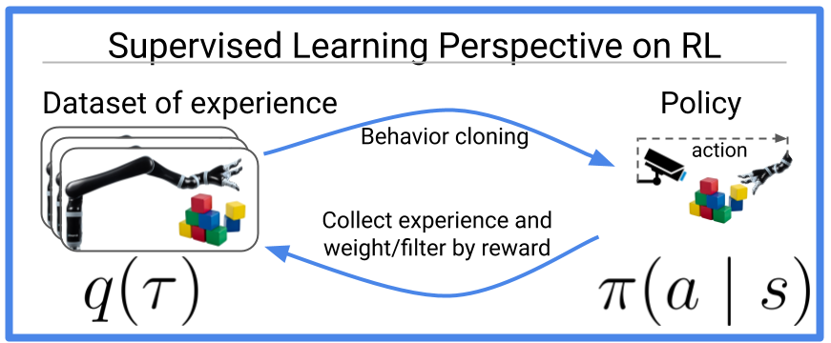
Reinforcement learning is supervised learning on optimized data
“RL might be viewed as a joint optimization problem over both the policy and the data. Seen from this supervised learning perspective, many RL algorithms can be viewed as alternating between finding good data and doing supervised learning on that data.”
Ben Eysenbach and Aviral Kumar and Abhishek Gupta Oct 13, 2020
https://bair.berkeley.edu/blog/2020/10/13/supervised-rl/
Notes:
Traditionally RL has been viewed as a class of problem and solution separate from supervised and unsupervised learning, but just last week, Eysenbach, Kumar and Gupta point out that RL can actually be framed as a joint optimization over policy and data that alternates between finding good data and learning on that data.
This implies we can use supervised learning to perform RL! Which is an interesting viewpoint.
Active field
It’s not solved

Slide 15
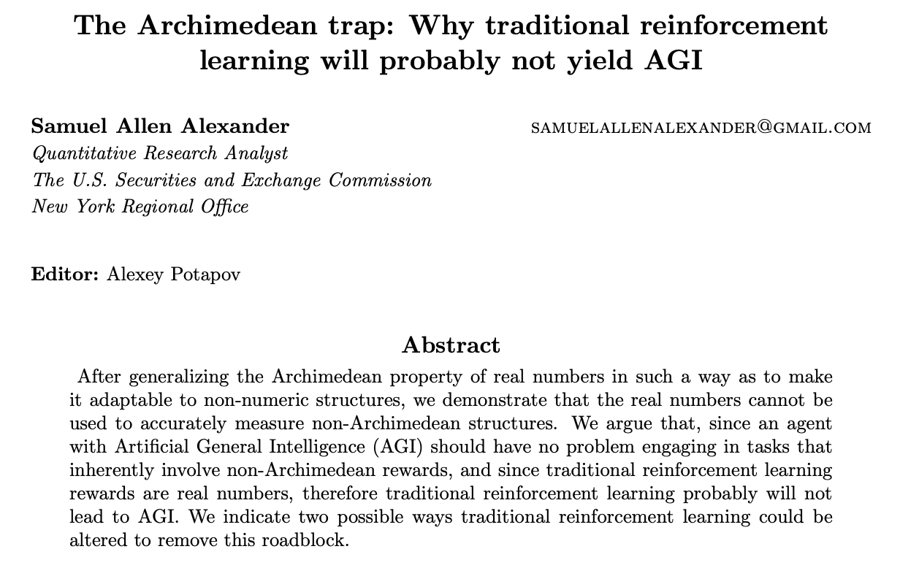
Limits of RL
https://philpapers.org/archive/ALETAT-12.pdf
Notes:
Another recent work, published just last month in the Journal of Artificial General Intelligence by this guy, Alexander at the Security and Exchange commission, which is a bit odd, claims RL won’t give us Artificial General Intelligence.
This is also kind of strange because I’m not sure anyone was assuming RL would yield AGI, nonetheless, RL is not a silver bullet. It has very real limits and is still the subject of much active research.
We can talk about this more later, but one advantage of RL vs supervised methods is that by allowing agents to explore and learn on their own, it could require much less information than supervised methods

Slide 16
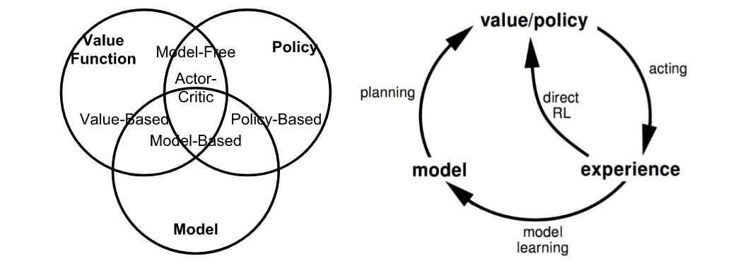
Reinforcement Learning
Lilian Weng, David Silver, https://youtu.be/2pWv7GOvuf0
Notes:
Ok, so let’s dig into the basics of RL.
The left figure here shows the various types of RL and the right the general process, which i’ll go over in detail
The agent is acting in an environment.
The environment reacts to certain actions is defined by a model may or may not be known.
The agent can stay in one of many states (s) of the environment, and choose to take one of many actions (a) to transition from one state to another.
Which state the agent will arrive in is decided by transition probabilities between states (P).
Once an action is taken, the environment delivers a reward (R) as feedback.

Slide 17
Reinforcement Learning
3 Main Tasks:
Sensing
Action
Goal
Reinforcement learning: An introduction. Sutton & Barto

Slide 18
Reinforcement Learning
6 Key Elements:
Agent
Environment
Policy (π)
Reward Signal
Value Function
Model of the Environment (known or unknown)
Reinforcement learning: An introduction. Sutton & Barto
Notes:
Agent is the actor in our environment
The Policy dictates how the agent acts given a state. This can be deterministic or stochastic
Value function measures the goodness of a state … or ... how rewarding a state or an action is. It does this by predicting a future reward.
The model of the environment can be known or unknown

Slide 19
Reinforcement Learning
Formalized as an optimal control problem on a Markov Decision Process (MDP), a tuple of (S, A, P, R, 𝛾)
Markov Property:
“The future is independent of the past given the present.”
Reinforcement learning: An introduction. Sutton & Barto
Notes:
This is formalized as an optimal control problem on a Markov decision process.
Recall a Markov decision process is a discrete-time stochastic control process where the conditional probability distribution of future states depends only on the current state.
MDP is a tuple of:
- State space S
- Finite action space is A
- State transition probability is P
- Reward function R
- Discount factor gamma
- this is a credit assignment variable. It is assigned a value in the range (0, 1). Where a higher value corresponds to more credit assigned to past actions.
Sampling from an MDP, we get a sequence of states or “an episode.”

Slide 20
Reinforcement Learning
Model-based or Model-free
Notes:
Model based methods rely on a model of the environment. Either the model is known or the algorithm learns it explicitly
Model free methods have no dependency on the model during learning

Slide 21
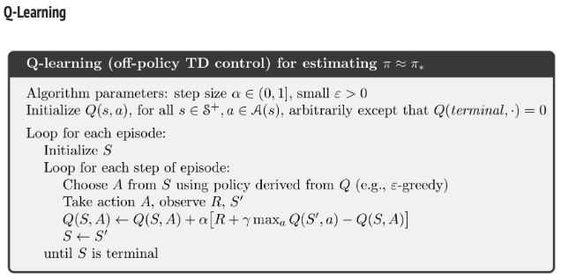
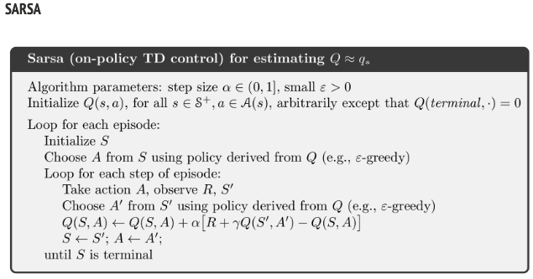
Reinforcement Learning
Off policy vs. On policy
https://leimao.github.io/blog/RL-On-Policy-VS-Off-Policy/
Notes:
To understand on policy and off policy, we first need to understand what the update policy and behavior policy are
Update policy is how your agent learns the optimal policy, and behavior policy is how your behaves.
When the update policy is different than the behavior policy, this is referred to as “Off policy”
Q-learning is an off policy example where the agent learns optimal policy using an absolute greedy policy and behaves using other policies such as the epsilon-greedy policy.
An epsilon-greedy policy is a way of selecting uniform random actions.
SARSA on the other hand is an example of on-policy learning, which learns optimal policy and behaves according to the same policy, such as epsilon-greedy.
I don’t have a slide for this, but I did want to mention the distinction between Value-based and Policy-based methods. Policy-based methods build a explicit representation of a policy (mapping π:s→a) and keep it in memory during learning. In Value-based learning we don't store any explicit policy, only a value function.

Slide 22
Reinforcement Learning
Methods
Dynamic programming
Policy Evaluation
Policy Improvement
Policy Iteration
https://lilianweng.github.io/lil-log/2018/02/19/a-long-peek-into-reinforcement-learning.html
Notes:
Dynamic programming is an approach that is possible when the model is fully known.
Using the bellman equations, policy evaluation is used to compute the state-value for a given policy
Then based on the value function, policy improvement generates a new policy by acting greedily
So general policy iteration (GPI) refers to an iterative process to improve the policy by combining these evaluation and improvement steps
https://lilianweng.github.io/lil-log/2018/02/19/a-long-peek-into-reinforcement-learning.html#key-concepts

Slide 23
Reinforcement Learning
Methods
Monte-carlo methods (model free)
Temporal-Difference (TD) Learning
SARSA: On-Policy TD control
Q-Learning: Off-policy TD control
Deep Q-Network
Policy Gradient
REINFORCE
https://lilianweng.github.io/lil-log/2018/02/19/a-long-peek-into-reinforcement-learning.html
Notes:
There are lots of other methods as you can see on this slide
https://lilianweng.github.io/lil-log/2018/02/19/a-long-peek-into-reinforcement-learning.html#key-concepts

Slide 24
Reinforcement Learning
Methods
Actor-Critic
Asynchronous Advantage Actor-Critic (A3C)
Evolution Strategies
https://lilianweng.github.io/lil-log/2018/02/19/a-long-peek-into-reinforcement-learning.html
Notes:
And the list goes on, but we won’t focus on these now. I would encourage you to read the blog post linked on this slide for a high level overview of each of these approaches
I do want to note that the term DeepRL simply means using a deep neural network for the policy.
https://lilianweng.github.io/lil-log/2018/02/19/a-long-peek-into-reinforcement-learning.html#key-concepts

Slide 25
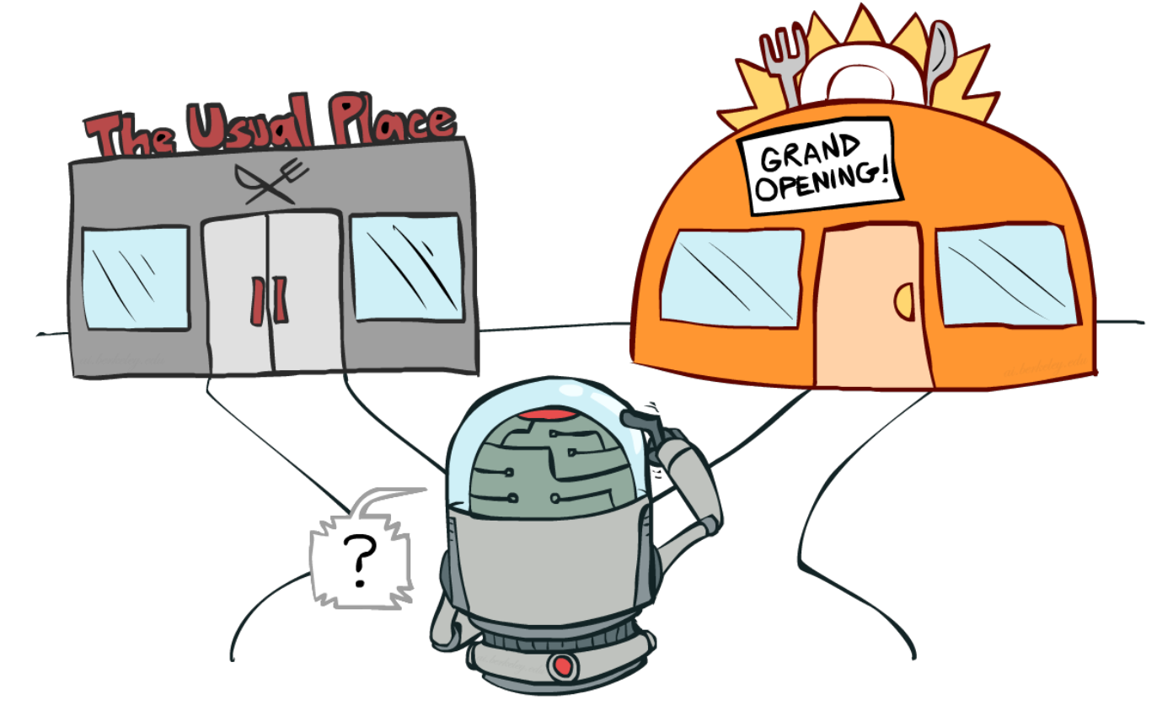
Reinforcement Learning: challenge
Exploration vs. Exploitation
https://lilianweng.github.io/lil-log/2018/01/23/the-multi-armed-bandit-problem-and-its-solutions.html
Reinforcement learning: An introduction. Sutton & Barto
Notes:
I also want to talk briefly about some challenges with reinforcement learning. The first of which is the exploration vs. exploitation problem. Should the agent…?
exploit what it already knows
explore in order to make better action selections in the future
The dilemma is that neither exploration nor exploitation can be pursued exclusively without failing at the task.
The agent must try a variety of actions and progressively favor those that appear to be best.
On a stochastic task, each action must be tried many times to gain a reliable estimate its expected reward.

Slide 26
Reinforcement Learning: challenge
Training is unstable and convergence challenging when these three factors are at play:
Off-policy method
Non-linear function
Bootstrapping
https://lilianweng.github.io/lil-log/2018/01/23/the-multi-armed-bandit-problem-and-its-solutions.html
Sutton & Barto
Notes:
The deadly triad, pointed out by Sutton and Barto in 2017 is when an off-policy method is combined with a nonlinear function and bootstrapping. This makes training very unstable and convergence challenging.
Methods such as DQN help address this with experience replay and an occasionally frozen target network.
I know I just used a bunch of terms I haven’t covered, but the main takeaway is training these can be very hard in practice given certain conditions.

Slide 27

Reinforcement Learning: challenge
Reward
https://lilianweng.github.io/lil-log/2018/01/23/the-multi-armed-bandit-problem-and-its-solutions.html
Sutton & Barto
Notes:
Finally, the specification of the reward is the key to a RL algorithm. This is what makes everything work and often it makes it work in unexpected ways.
Note that the reward function itself can be learned, either implicitly or explicitly via techniques such as inverse reinforcement learning.

Slide 28
Reinforcement Learning
“there are no general principles to be discovered, that intelligence is instead due to the possession of vast numbers of special purpose tricks, procedures, and heuristics”
“Weak” vs “Strong”
Weak: based on general principles (e.g. learning-based)
Strong: based on specific knowledge (e.g. hand-picked features)
Reinforcement learning: An introduction. Sutton & Barto
Notes:
Sutton and Barto highlight the interesting idea of “Weak vs. strong” methods.
They claim that since the 1960’s Since the late 1960's, AI researchers presumed there are no general principles to be discovered, that intelligence is instead due to the possession of vast numbers of special purpose tricks, procedures, and heuristics“
I think generality of knowledge is still much open to debate but the function approximation power of neural networks does seem to generalize at least over a given distribution of data.

Slide 29

Notes:
An obvious counter example to the “Weak vs. Strong” assumption is AlphaGo and it’s self-supervised successor AlphaZero. They both generalize over the data to which they are exposed.
While AlphaGo required lots of supervision and therefore human time and cost, AlphaZero depends on self-supervision and decreases this, but there is much room for improvement in terms of efficient learning from a small amount of data.
This is where the a modern parallel to what were called “weak vs. strong” methods has the potential to shine. Symbolic vs. neural methods, as we talked about in class previously are an obvious path forward.
Using prior knowledge, or semantic priors, could decrease the time and cost to train learning systems.

Slide 30
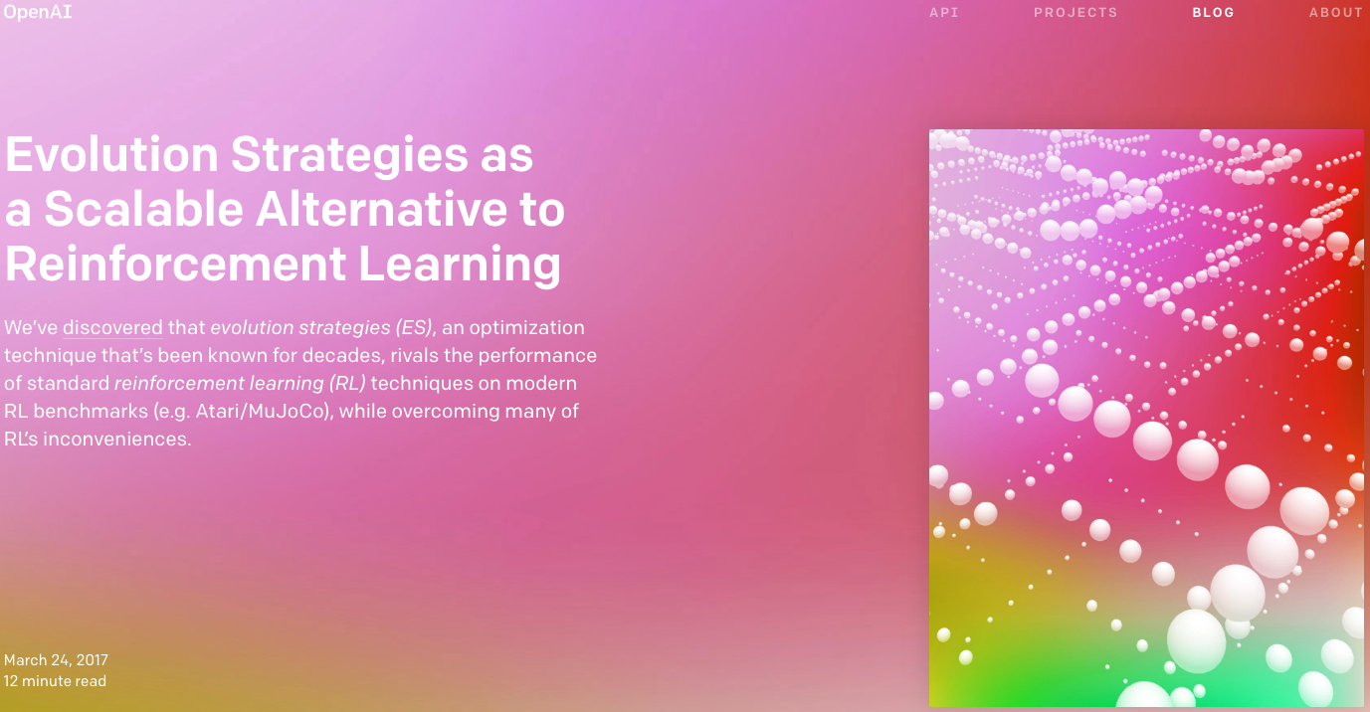
Evolutionary Methods
Notes:
I want to quickly touch on an interesting alternative to RL: evolutionary strategies.
Evolutionary strategies are inspired by but far removed at this point from biological evolution
A black box optimization strategy
There is no notion of a agent, no notion of an environment, and no notion of neural networks.
Just all of the parameters (for our neural network, but we ignore that) go in and one value (the total reward) come out. And optimize this function without assumption
The algorithm is basically “guess and check”
This is interesting because it is the opposite direction of the symbolic + neural approaches -- there are no priors and in theory this makes it impossible to limit the parameter space, making the whole approach much less efficient.
At the same time, there are some benefits:
There is no need for backpropagation, so we can optimize networks that are not differentiable.
It’s robust as parameters that must be set in RL can be avoided
Exploration of parameter space can be structured, for better or worse. One problem with the RL policy gradient approach is that the randomly initialized policy can randomly jitter in one spot for a long time

Slide 31
Paper 1: Go for a Walk and Arrive at the Answer: Reasoning Over Paths in Knowledge Bases using Reinforcement Learning
Rajarshi Das, Shehzaad Dhuliawala, Manzil Zaheer, Luke Vilnis, Ishan Durugkar, Akshay Krishnamurthy, Alex Smola, Andrew McCallum
ICLR 2018
Notes:
International Conference on Learning Representations -- an ML conference

Slide 32
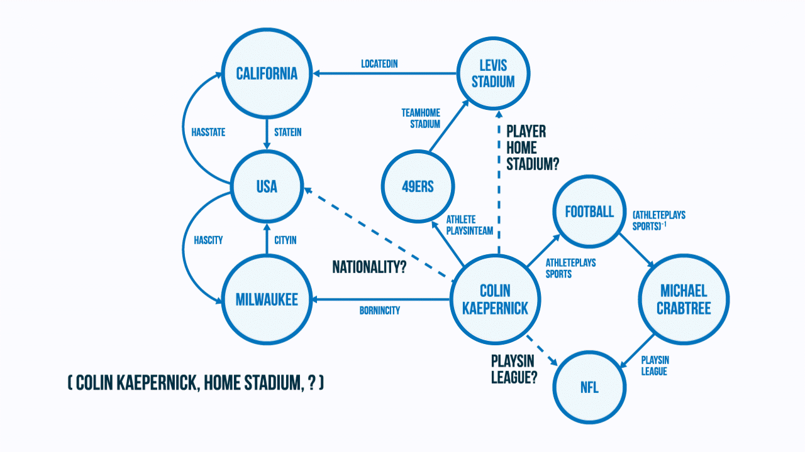
Das et al., Go for a Walk and Arrive at the Answer: Reasoning Over Paths in Knowledge Bases using Reinforcement Learning
MINERVA Query: “(Colin Kaepernick, PLAYER HOME STADIUM, ?)”
Notes:
Their approach is called “MINERVA,” which is a RL agent which answers queries in a knowledge graph of entities (shown as nodes in the graph here) and relations (which are edges).
Starting from an entity node, MINERVA learns to navigate the graph conditioned on the input query till it reaches the answer entity.
For the example, given the query, “(Colin Kaepernick, PLAYER HOME STADIUM, ?)”, MINERVA takes the highlighted path in the knowledge graph
Only the solid edges are observed in the graph, the dashed edges are unobserved.

Slide 33
Task
Das et al., Go for a Walk and Arrive at the Answer: Reasoning Over Paths in Knowledge Bases using Reinforcement Learning
Infer valid facts from a knowledge base
Uses only one entity and the relation
E: set of entities
R: set of binary relations
The Knowledge Base (KB) is a collection of facts: (e1, r, e2)
Notes:
Previous path-based models have only considered predicting a missing relation given two entities or evaluating ground truth triples.
However, in this work, only a single entity is used along with the query.
To make this a bit more formal, E is the set of entities, and R is the set of binary relations, then facts in the knowledge base are triplets in the form (entity 1, relation, entity 2)

Slide 34
Task
Das et al., Go for a Walk and Arrive at the Answer: Reasoning Over Paths in Knowledge Bases using Reinforcement Learning
Querying: (e1; r;?), e.g. (Toronto, located In, ?)
Fact prediction: (Toronto, located In, Canada) -- True or Not?
Notes:
Querying asks a question in the form shown here entity1, relation, then the unknown
The proposed work is a query answering model, that learns to efficiently traverse the knowledge graph to find the correct answer to a query, avoiding the need to evaluate all entities.
Fact prediction can be framed basically a binary classification problem.
Fact prediction algorithms can be used for query answering, but since all candidate answer entities must be evaluated, it is way too slow for large Knowledge Bases
This is why fast traversal is important.
Not being an NLP person, I don’t deeply understand the subtleties in this distinction between Fact Prediction and Query answering, if any wants to jump in with any clarifying points?

Slide 35
Method: MINERVA
Das et al., Go for a Walk and Arrive at the Answer: Reasoning Over Paths in Knowledge Bases using Reinforcement Learning
Add inverse edges: e.g. for (e1, r, e2) add (e2, r⁻¹,e1) to the graph
Notes:
The first thing to note is that as part of the method for this paper, the knowledge base, which is by definition a directed, labeled graph, is augmented with inverse relations for every edge. This follows previous approaches.
The authors found that this allowed the agent to undo partially incorrect decisions.

Slide 36
Method: MINERVA
Das et al., Go for a Walk and Arrive at the Answer: Reasoning Over Paths in Knowledge Bases using Reinforcement Learning
Add inverse edges: e.g. for (e1, r, e2) add (e2, r⁻¹,e1) to the graph
Input is the query (e1; r;?). Agent traverses the graph. Stopping on the node that predicts the answer.
Notes:
With the input query the agent traverses the graph stopping at the node that predicts the query.

Slide 37
Method: MINERVA
Das et al., Go for a Walk and Arrive at the Answer: Reasoning Over Paths in Knowledge Bases using Reinforcement Learning
Add inverse edges: e.g. for (e1, r, e2) add (e2, r⁻¹,e1) to the graph
Input is the query (e1; r;?). Agent traverses the graph. Stopping on the node that predicts the answer.
Training via policy gradients (REINFORCE method)
Notes:
Using a training set of known facts, the agent is trained using policy gradients more specifically by REINFORCE
REINFORCE is a Monte-Carlo policy gradient method that relies on estimated return by Monte-Carlo methods. Episode samples are used to update the policy parameter θ. REINFORCE works because the expectation of the sample gradient is equal to the actual gradient.

Slide 38
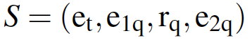
Method: MINERVA
Das et al., Go for a Walk and Arrive at the Answer: Reasoning Over Paths in Knowledge Bases using Reinforcement Learning
Add inverse edges: e.g. for (e1, r, e2) add (e2, r⁻¹,e1) to the graph
Input is the query (e1; r;?). Agent traverses the graph. Stopping on the node that predicts the answer.
Training via policy gradients (REINFORCE method)
POMDP
Notes:
Partially observable markov decision process is comprised of: (State, Observations, Actions, Transition, Rewards)
State is shown on the slide along with the observation.
E_t is the entity at time t, Entity e_1_q and relation r_q encode the query, the answer is eq2 which is not observable, as denoted on the slide
Actions consist of all outgoing edges from e_t
Transition simply updates the current state to the state along the selected edge
Reward is one when the final node is the correct answer after rolling out the policy the fixed number of steps and zero otherwise

Slide 39
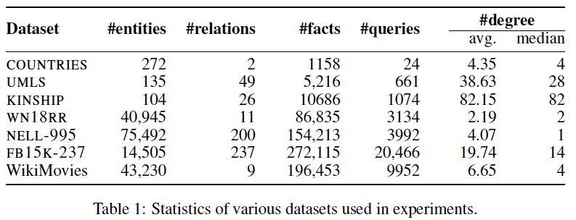
Datasets
Das et al., Go for a Walk and Arrive at the Answer: Reasoning Over Paths in Knowledge Bases using Reinforcement Learning
7 Knowledge bases
Notes:
As for the datasets, there are 7 knowledge bases that were used.
These statistics are from the paper. Degree here refers to the graph, indicating an average or median number of adjacent vertices to a given node.
An interesting point about these datasets is the size ranges quite significantly

Slide 40
Results
Das et al., Go for a Walk and Arrive at the Answer: Reasoning Over Paths in Knowledge Bases using Reinforcement Learning
Baselines
Embedding based models: DistMult (Yang et al., 2015), ComplEx (Trouillon et al., 2016), and ConvE (Dettmers et al., 2018)
Learning logical rules: Neural Theorem Provers (NTP) (Rockt¨aschel & Riedel, 2017) and NeuralLP (Yang et al., 2017)
Notes:
MINERVA results are compared with these 5 methods

Slide 41
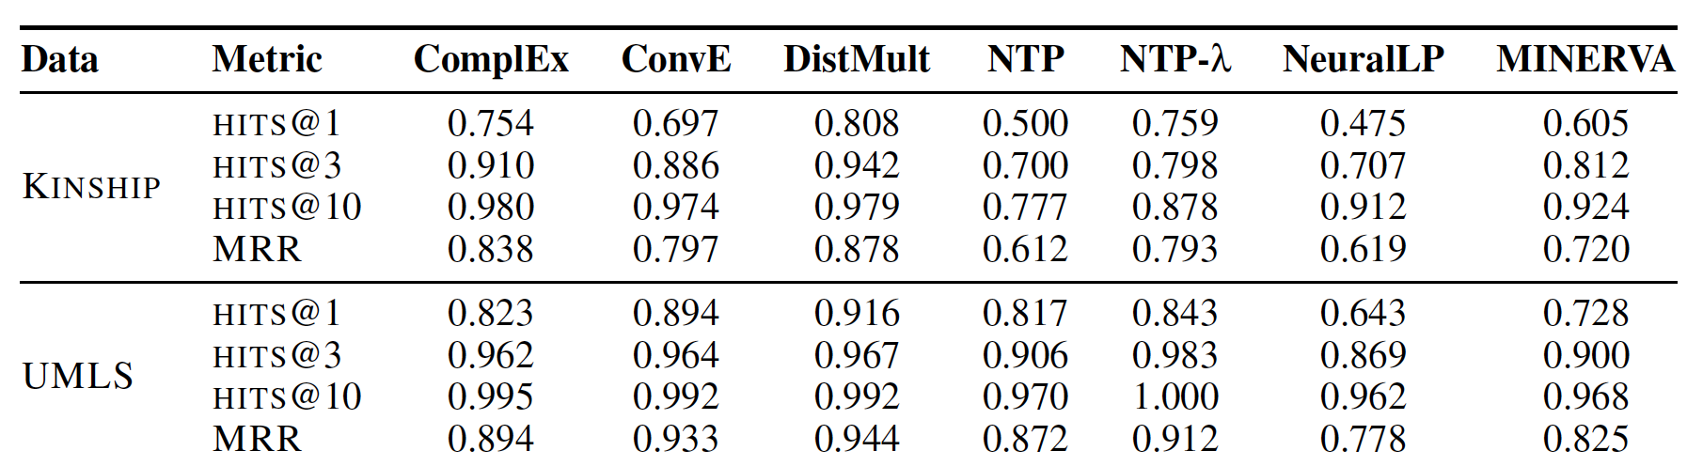
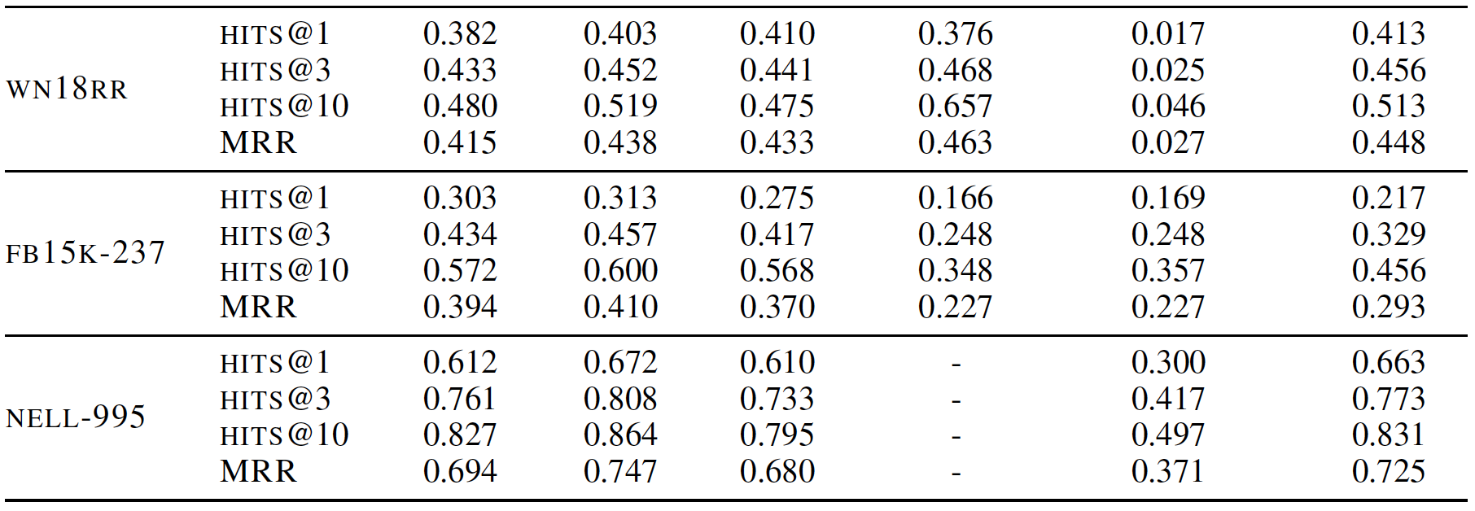
Results
Das et al., Go for a Walk and Arrive at the Answer: Reasoning Over Paths in Knowledge Bases using Reinforcement Learning
Notes:
The additional metric, NTP-lambda is NTP with an additional loss term. This method does not scale to NELL-995 so there are no results.
The two smaller datasets are at the top and three bigger datasets are at the bottom
Comparison is done via the hit ratio metric at k with values of k in {1,3,10}
Overall MINERVA performs well.
They also compare against DeepPath and talk about training and inference time.
Training appears to converge in about 15 minutes on NELL-995 and slightly less on WN18RR.
Inference time is constant with a median of 63 seconds.

Slide 42
Paper 2: Look Before You Leap: Bridging Model-Free and Model-Based Reinforcement Learning for Planned-Ahead Vision-and-Language Navigation
Xin Wang, Wenhan Xiong, Hongmin Wang, William Yang Wang
ECCV 2018
Notes:
European Conference on Computer Vision -- CV conference

Slide 43
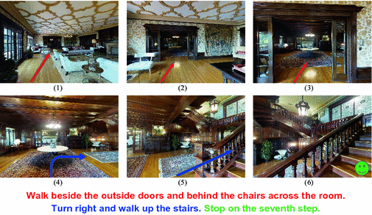
Task
Wang et al., Look Before You Leap...
Notes:
“Vision-and-Language Navigation (VLN) is the task of training an embodied agent which has the first-person view as humans to carry out natural language instructions in the real world”
An example of our task. The robot learns to navigate through the room and arrive at the destination (indicated in green) by following the natural language instructions.
Colored arrows match the text.
The robot takes as input the visual scene and follows the natural language instructions.
In contrast to Visual Question Answering, in Visual-and-Language Navigation, the agent can interact with the environment and the pixels it perceives change as it moves.
The agent must learn to map its visual input to the correct action based on its perception of the world and understanding of the natural language instruction.

Slide 44
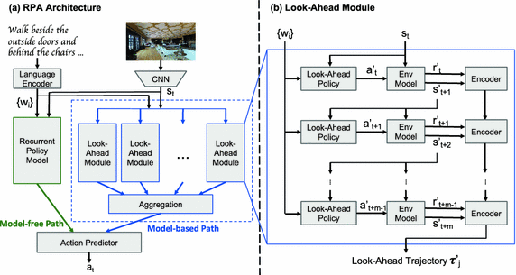
Method: Reinforced Planning Ahead (RPA)
Wang et al., Look Before You Leap...
Notes:
The model consists of a
language encoder that encodes the instruction X as word features,
an image encoder that extracts high-level visual features,
a recurrent policy network (shown in green on the left) that decodes actions and recurrently updates its internal state. This encode the history of previous actions and observations into a model-free path
The look-ahead module uses the environment model to take into account the future predictions. This module is the unique aspect of this work and the authors claim they are the first to combine model-free and model-based DRL for vision-and-language navigation.

Slide 45
Method
Wang et al., Look Before You Leap...
State:
Action: {turn left, turn right, camera up, camera down, move forward, stop}
Notes:
The lookahead module consists of three components. The look-ahead component makes a prediction in state space, not on the raw RGB image (as a GAN or VAE might do).
State consists of pose p composed of {spatial position v, heading rho and elevation angle theta}, and sequence of words X
The output of the lookahead module is imagined action a prime at t

Slide 46
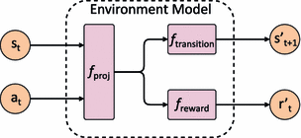
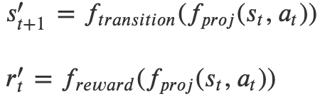
Method
Wang et al., Look Before You Leap...
State:
Action: {turn left, turn right, camera up, camera down, move forward, stop}
Notes:
The environment model then takes the state and imagined action and predicts the corresponding reward and next state.
By the way, I believe they choose to call this an “imagined action”, because they’re predicting some state that may not be realized by the robot.
An long short term memory network encodes the predicted rewards and states. They then roll this out over the entire preset trajectory length.

Slide 47
Method: Reinforced Planning Ahead (RPA)
Wang et al., Look Before You Leap...
Notes:
All lookahead trajectories (tau prime j in the diagram) are concatenated and passed to the action predictor
They do go into the details of the of architecture and training of the underlying networks, which you can see in the paper.
There doesn’t seem to be much of note as they seem to do all the normal stuff, for example convolutional neural networks for images and sequences are handled with LSTMs. The action predictor is a multilayer perceptron with sigmoid activation giving a probability over the action space.
Though, it is a bit odd to me, as a person with a vision background and little NLP experience, that they never explicitly talk about the language encoder other than saying it encodes instructions as word features.
Maybe someone in NLP can tell me if this is normal and these are too common to describe, even in the slightest detail?
One other logistical note they make bout training ist hat in the look-ahead module, the environment model and policy model have their own language encoders and are trained separately. I’m not sure what this means as the language encoder is obviously outside the lookahead module on the diagram.

Slide 48
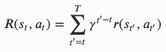
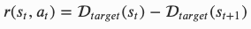
Reward
Wang et al., Look Before You Leap...
Global Distance
Success: {0,1}
Discounted
Discounted and Success (used in final model)
Notes:
4 reward functions were tested
The Global Distance reward function is defined per path by assigning the same reward to all actions along this path. This reward measures how close the agent is to the target.
The Success reward is a binary reward: if the path is correct, then all actions will be assigned with a reward 1, otherwise reward 0.
The Discounted reward is defined as shown in the equation here. Where D_target is the distance between state s and the target position. So immediate reward (shown on the right) after taking action a_t at state s_t is the change in distance to the target .
Finally, Discounted and Success reward, which is used in the final model,is just the sum of the Success binary reward to the immediate reward of the final action and Discounted reward is computed as above (as shown on the left)

Slide 49
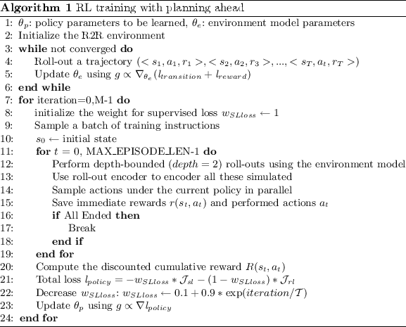
Reward
Wang et al., Look Before You Leap...
Notes:
They do talk about training. They tried both a mixed loss function and warm-start via supervised learning but chose using mixed loss as it converges faster with better performance.
They also note the whole system must be trained in two-steps, first learning the environment model then the enhanced policy module during which the environment model is fixed.

Slide 50
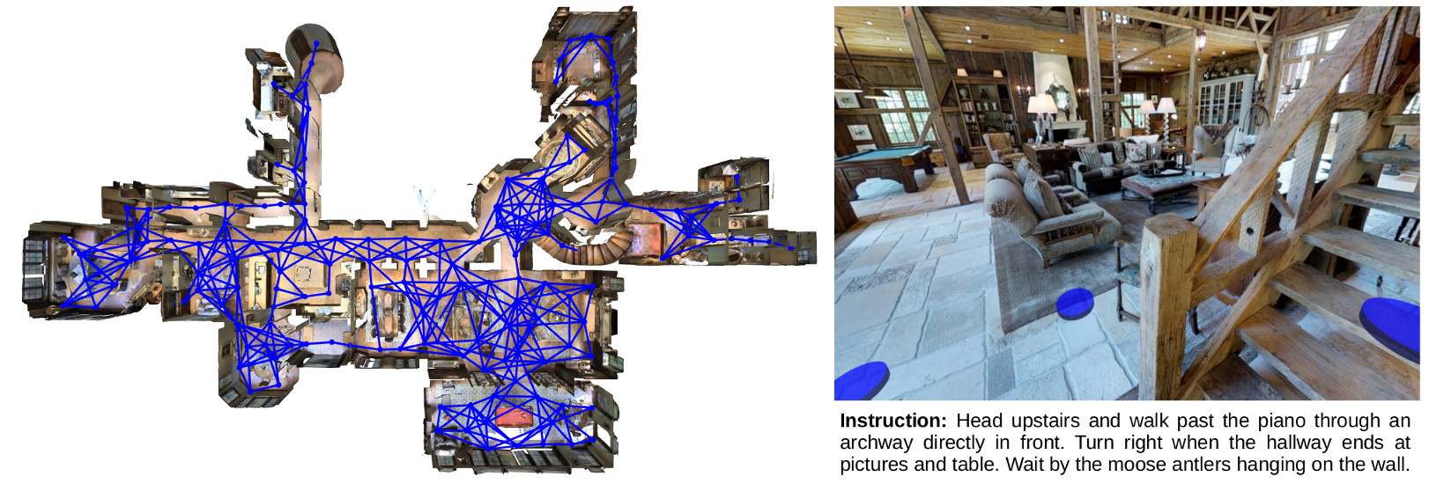
Dataset
https://github.com/peteanderson80/Matterport3DSimulator
Notes:
Evaluation is done on the Room to Room dataset, which is a vision-and-language dataset for navigation in 3D built on the matterport dataset.
They use the Matterport3D simulator for all training and evaluation

Slide 51
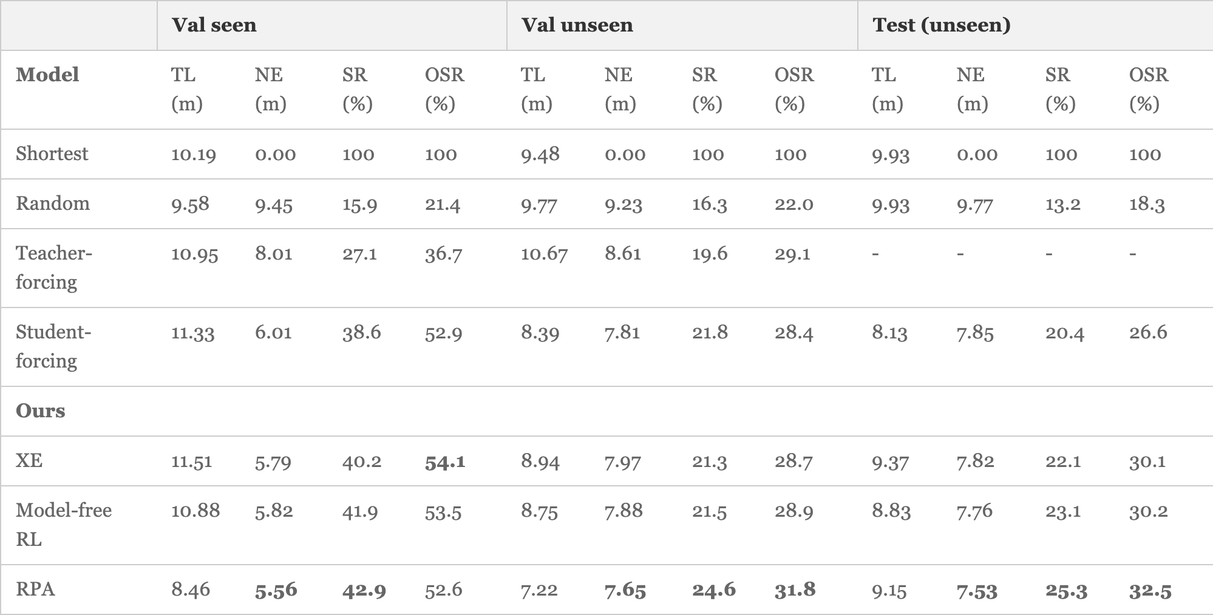
Results
Wang et al., Look Before You Leap...
Notes:
Here’s the big table of results.
Reported metrics here are:
Trajectory Length (TL): not actually a metric
Navigation Error (NE): final distance to goal
Success Rate (SR): success is defined as a final position w/in 3m of the final goal
Oracle Success Rate (OSR): distance between the closest point on the trajectory and the destination, ie. how close the robot got to the goal
In general it seems like RPA does well. That said, I’m always a bit skeptical of these robot navigation metrics as there is not a clear set of community accepted metrics everyone compares against in a fair way. Instead people tend to pick baselines and metrics that makes their method look good.
One final note is that there is nowhere near enough information in the paper to accurately reproduce the results, lots of necessary information from architecture to training regiment is glossed over and I could not find any code. In general, I would not call this paper reproducible.

Slide 52
Paper 3: Language as an Abstraction for Hierarchical Deep Reinforcement Learning
Yiding Jiang, Shixiang Gu, Kevin Murphy, and Chelsea Finn
NeurIPS 2019
Notes:
Neural Information Processing Systems -- ML Conference

Slide 53
Problem
Find general abstractions for hierarchical RL
Language for Hierarchical DeepRL. Jiang et al.
Notes:
Training a hierarchy of policies is one way to deal with long-horizon tasks
The question is then how does one deal with the abstraction between high level and low level policies?
The obvious answer is that they can be hard coded for specific tasks or they can be learned. The problems are that hard code is not generalizable and learning them is very difficult.

Slide 54
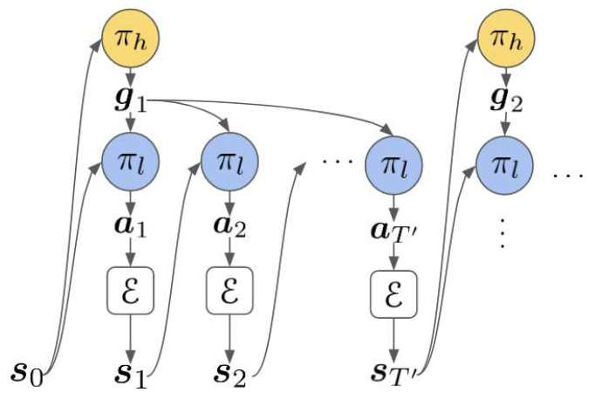
Problem
Language for Hierarchical DeepRL. Jiang et al.
Notes:
I’m going to cheat in describing the problem and show the solution right up front and how language is used as an abstraction. The authors work with a 2-layer hierarchical policy shown on this slide. Compositional language is used as as the abstraction between the high-level policy and the low-level policy
Shown here in the figure, the high level policy pi h produces language instructions for g for low level policy pi L
The authors give 4 reasons to use language as an abstraction:
Humans use language as an abstraction for reasoning and planning
Language abstractions are a generalization of goal states
High level policies are interpretable (because they give output as language)
Low level policies can be reused

Slide 55
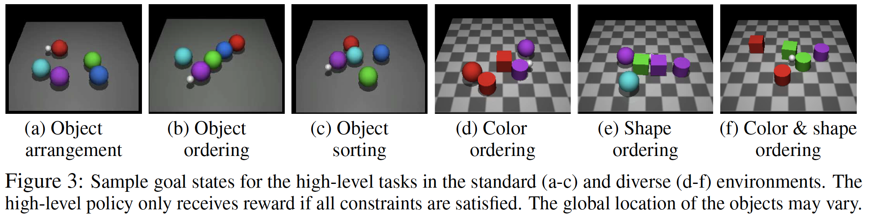
Task
Language for Hierarchical DeepRL. Jiang et al.
Notes:
6 challenging temporally-extended tasks across two environments in a unique
This is done in a simulation created by the authors that allows the agent to interact with a scene. The simulation is built on the MuJoCo physics engine and CLEVR.

Slide 56
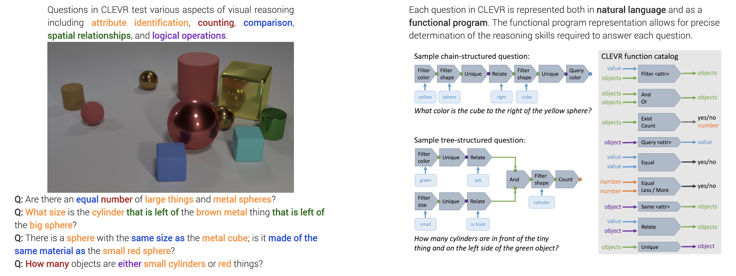
CLEVR
https://cs.stanford.edu/people/jcjohns/clevr/
Notes:
Just a quick reminder, CLEVR is a tool for generating images and questions as shown here. Questions are represented in both natural language and a functional program.

Slide 57
Method
Goal conditioned reinforcement learning
Augmented Markov Decision Process: (S, G, A, T, R, 𝛾)
represents the reward of each transition under a given goal
Policy is conditioned on G:
Objective is to find a policy to maximize the expected discounted future reward
Language for Hierarchical DeepRL. Jiang et al.
Notes:
The problem is formulated as an Agumented Markov Decision Process where the extra term G is the space of all possible goals.
- State space S
- Goal G
- Finite action space is A
- State transition probability is T
- Reward function R
- Discount factor gamma

Slide 58
Method: Hierarchical Abstraction w/ Language (HAL)
Language for Hierarchical DeepRL. Jiang et al.
Notes:
Going back to the method, it needs to be noted that in addition to the goal conditioned RL formulation, we need some supervision to give some mapping between observations and a distribution of language statements.
This supervision can be in the form of a supervised image captioning model, a human supervisor, or a functional program that is executed on the state. This last option, the functional program is how it is handled in CLEVR.
The other element of supervision is some function that can map state to a boolean value indicating if the instruction was satisfied or not. This function can serve as the reward for the low level policy.
The “goal conditioned” part of the RL name comes from a trick used during training the low level policy: trajectories are re-labeled with languaged instructions that match their final state, even if they don’t reach their initially intended goal. This helps solve the problem of sparse reward by rewarding all trajectories, not just rewarding ones in which case the trajectory is completed.
The high level policy’s reward comes from the environment and trained in a method similar to DQN. They also explore how one might incorporate a language model into the high level policy by learning a disentangled representation of language via a InfoGAN, but this did not work well enough to make it into the paper and it lives in an appendix
The high and low level policies are trained separately.

Slide 59
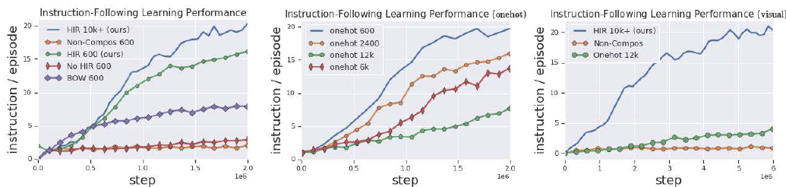
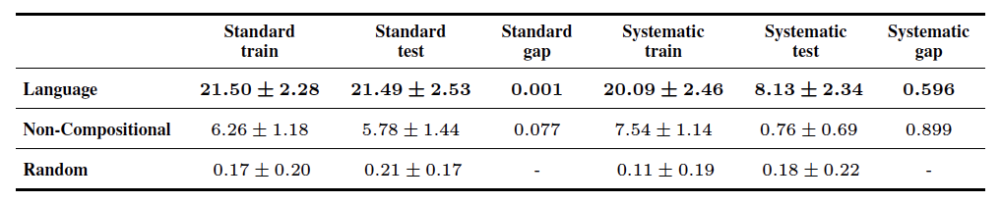
Results: Language vs. Other Representations
Language for Hierarchical DeepRL. Jiang et al.
Notes:
In the paper there are results that attempt to answer a whole bunch of different questions, but I’m going to focus only on how a language representation compares to alternative representations, such as those that are not explicitly compositional?
In short the compositional language method does better than a one-hot encoded representation, a non-compositional language representation, and bag of words representation on instruction following.
It also generalizes better with language than with non-compositional representation.
The top row of plots show goal completions per episode over training.
HIR is the re-labeling method I described. They also tried without re-labeling, but this seems to be necessary.
This table shows the performance of the low-level policy on different training and test instruction distributions after 20 episodes.
Standard and systematic refer to how the train and test split is constructed: random for the standard split and systematic removes instructions with a specific word from the train set while the test set requires these words to be present.
Gap is equal to one minus the ratio of between mean test performance and mean train performance; this quantity can be interpreted as the generalization gap.
The table shows the agent generalizes better with language than with non-compositional representation
It is notable, they don’t use reward shaping. (that is, adding some supplemental reward specific to a specific problem)
Limitations:
method relies on instructions provided by a language supervisor
Instruction set used is specific to our problem domain, which is maybe not as general as initially claimed in the benefits of using language
The authors question how to enable an agent to follow a much more diverse instruction set, that is not specific to any particular domain, and learn compositional abstractions without the supervision of language.
supervision of language
See the paper if you’re interested in other questions
(2) How well does the framework scale with the diversity of instruction and dimensionality of the state (e.g. visionbased observation)?
(3) Can the policy generalize in systematic ways by leveraging the structure of language?
(4) Overall, how does our approach compare to state-of-the-art hierarchical RL approaches, along with learning flat, homogeneous policies?

Slide 60
Discussion

Slide 61
Discussion: Methods of Learning
Given the different approaches to learning: Supervised vs. Unsupervised vs. RL vs. DeepRL vs. Evolutionary Strategies, how does one make a decision about the best strategy for a given problem?

Slide 62
Discussion: (Deep)RL + other methods
How might (Deep)RL based methods be blended with other methods for improved performance on tasks such as knowledge base querying or vision-and-language navigation? E.g. neuro symbolic methods? semantic priors?

Slide 63
Discussion: Language as representation
In what other fields/areas/tasks could the compositional structure of language be leveraged as a representation?

Slide 64
Appendix

Slide 65
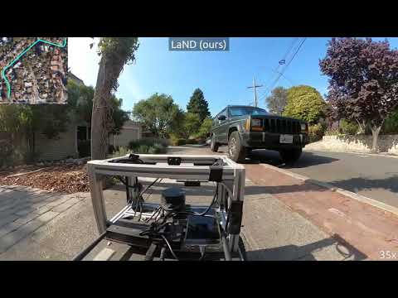
https://sites.google.com/view/sidewalk-learning
Notes:
LaND: Learning to Navigate From Disengagements

Slide 66



ML Frameworks
https://thegradient.pub/state-of-ml-frameworks-2019-pytorch-dominates-research-tensorflow-dominates-industry/
Notes:
Before we dig into RL, I just wanted to highlight some of the most common ML frameworks.
Competing for the top spot in the ML framework popularity contest are PyTorch and Tensorflow.
I mention flux, which is Julia’s ML library, because Julia is a rising programming language that users claim is both fast and user friendly.
The main problem with Flux and Julia, I’ve actually used both, is the ecosystem is far less developed than the Python ecosystem. Perhaps this will change in the future.

Slide 67
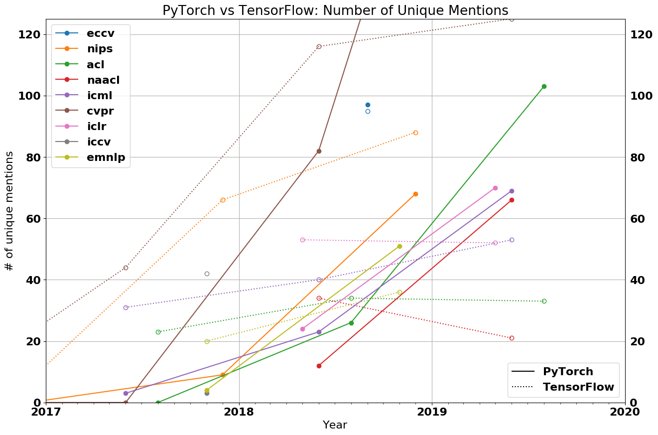
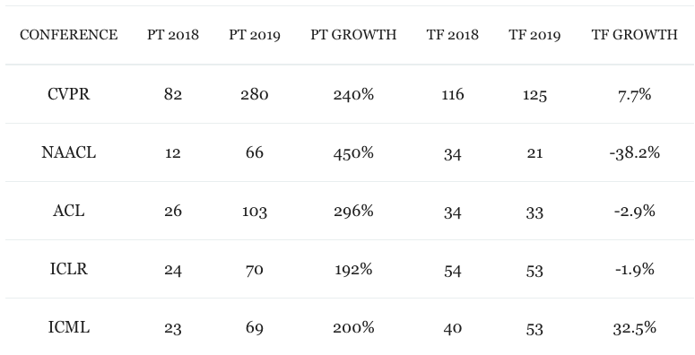
ML Frameworks
https://thegradient.pub/state-of-ml-frameworks-2019-pytorch-dominates-research-tensorflow-dominates-industry/
Notes:
Looking at the popularity of PyTorch vs Tensorflow:
Tensorflow used to be the hotness, as recently as 2018, but since then pytorch has seen a huge rise in popularity, atl least in academic works.
If I had to guess why, it probably has to do with complexity difference. Implementing something in pytorch is usually just way more straightforward than tensorflow, which was at times perhaps overengineered. The Keras api is Tensorflow’s attempt to fix this, but when things go wrong, one often ends up debugging in Tensorflow’s execution graph which is just a nightmare.

Slide 68
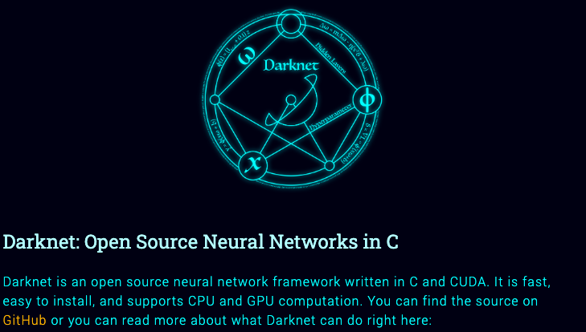
ML Frameworks
https://pjreddie.com/darknet/
Notes:
It’s also possible to write neural networks in pure Python or even better, pure C (with GPU acceleration via CUDA), but there’s no reason to do this, unless you have some very specific reason.

Slide 69
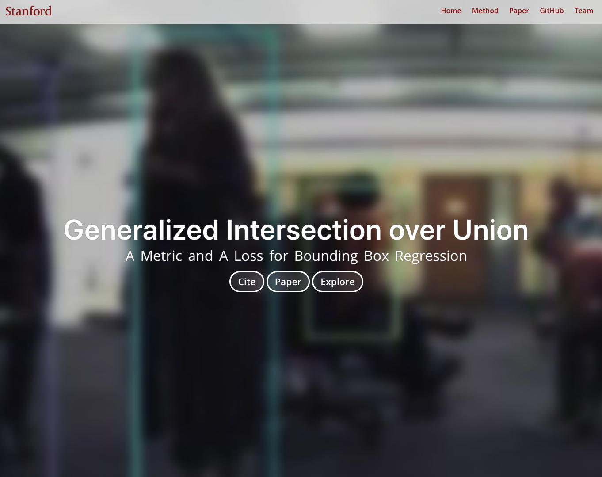
ML Frameworks
https://pjreddie.com/darknet/
Notes:
Such as we had in this paper, where we wanted to exactly reproduce the results from a prior work and the code was implemented in Darknet.
If you do go this route, you’ll probably need to do a bunch of things manually, like calculating gradients for backprop by hand, which is painful and wholly unnecessary with so many good autograd libraries available today.

Slide 70
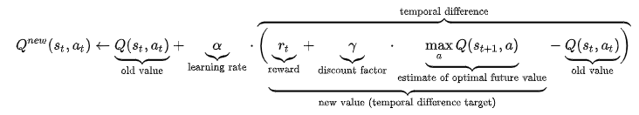
Reinforcement Learning
https://en.wikipedia.org/wiki/Q-learning
Notes:
Q-learning is a model-free reinforcement learning algorithm to learn quality of actions telling an agent what action to take under what circumstances.
The value function in Q-learning as an action value function.
It does not require a model (hence the connotation "model-free") of the environment, and it can handle problems with stochastic transitions and rewards, without requiring adaptations.
The quality of astate-action combination is calculated as Q or “quality”
Updates to Q are made via the bellman equations, which are a set of equations which decompose the value function into the immediate reward plus the discounted future values.

